Slide 1
Analysis of Airbnb Data for Property Purchase Recommendation in Amsterdam
Varsha Khanna
Notes:
Analyzig Airbnb data for poperty purchase reccomendations in Amsterdam.
Link to pdf of prpblem statement
Use agenda slide (make it crip)
Reference the fact that analysis of Airbnb raw data

Slide 2
Key Question(s)
Which neighborhood should the investor make an investment ?
a) Which boroughs ?
b) Which neighborhoods within the boroughs?
c) Identify top one or two neighborhoods.
d) Invest in Home vs Apartment?
Notes:
Feel free to add notes here

Slide 3
Analysis Methodology
Identify Boroughs Select Neighborhoods Select investment from boroughs location
Overall Guiding Principles
Proximity to Tourist spots
Cheaper Property Prices in the neighborhood
Low Concentration of Airbnb rentals
High Monthly Income
We will be using data from Airbnb’s current repository of properties in Amsterdam

Slide 4
Key Question(s)
Which neighborhood should the investor make an investment ?
a) Which boroughs ?
b) Which neighborhoods within the boroughs?
c) Identify top one or two neighborhoods.
d) Invest in Home vs Apartment?
Notes:
Feel free to add notes here

Slide 5
Identifying Boroughs
Based on Client Preferences + Guiding Principles:
Nieuw West & Zuid – Close to touristy spots, cheaper property prices in neighborhoods, low concentration of Airbnb rentals.
Noord – Proximity to centrum, low concentration of Airbnb rental
West is ruled out as it already has a very high concentration of Airbnb rentals, though it was a client preference

Slide 6
Neighborhood Comparison
Property Ranking-Cheapest Neighborhood is ranked #1
Notes:
Boroughs needs down arrow and column
Neighbound label missing . Need right arrow
Gridify entire slide
Use asterix for legend

Slide 7
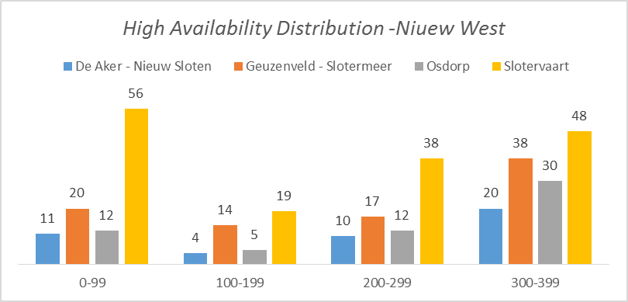
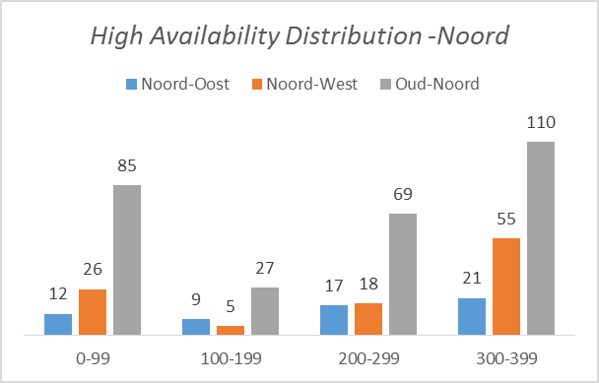
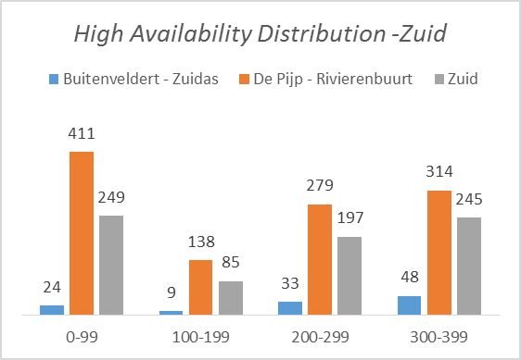
Availability of Rentals by Days

Slide 8
Key Question(s)
Which neighborhood should the investor make an investment ?
a) Which boroughs ?
b) Which neighborhoods within the boroughs?
c) Identify top one or two neighborhoods.
d) Invest in Home vs Apartment?
Notes:
Feel free to add notes here

Slide 9
Identifying Neighborhoods
Assuming investor’s risk appetite for investment is medium, the following neighborhoods are attractive
Geuzenveld – Slotermeer, Nieuw West
Noord West, Noord
Zuid, Zuid
Common features of these neighborhoods
Proximity to tourist attraction
Some presence of Airbnb rentals already. People using Airbnb depend heavily on reviews. Existing rentals will vouch for the locations and attract new tourists
Existing rentals provide trajectory of income and expense
Moderate investment requirement since all are ranked 2nd on heat map
Second highest on average in the availability spectrum
Unsaturated neighborhoods and can potentially add more listings
Notes:
Risk appetite

Slide 10
Analyzing Identified Neighborhoods
 | Geuzenveld – Slotermeer (GS) | Noords West (NW) | Zuid
Popularity (Count of reviews) | 77 | 84 | 627
Avg Monthly Income % of Total Amsterdam Income | $1117 (0.6% ) | $1256 (0.79%) | $1673 (7.8%)
% Amsterdam Listing | 0.91% | 1.06% | 8%
Expense/ Monthly Income | 14% | 30% | 25%
Expense=3% Host Fee+$50 Supplies
Notes:
Analyzing identified neighborhoods

Slide 11
Key Question(s)
Which neighborhood should the investor make an investment ?
a) Which boroughs ?
b) Which neighborhoods within the boroughs?
c) Invest in Home vs Apartment?
d) Identify top one or two neighborhoods.
Notes:
Feel free to add notes here

Slide 12
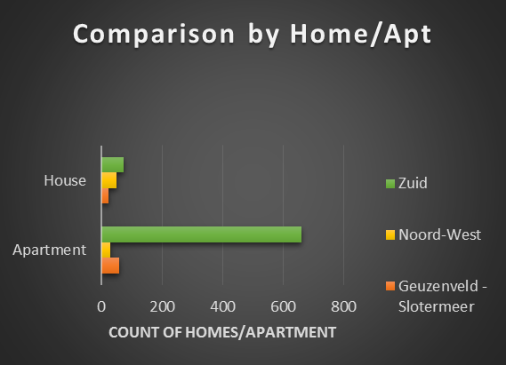
Invest in Home vs Apartment?
Notes:
X axis label (Airbnb rentals)

Slide 13
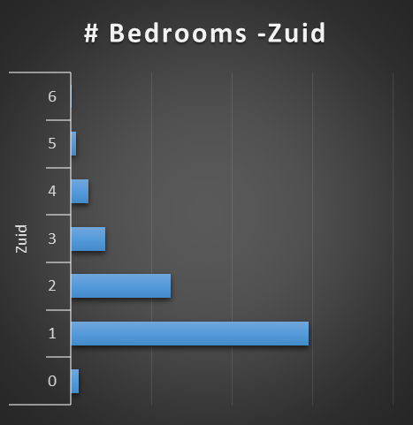
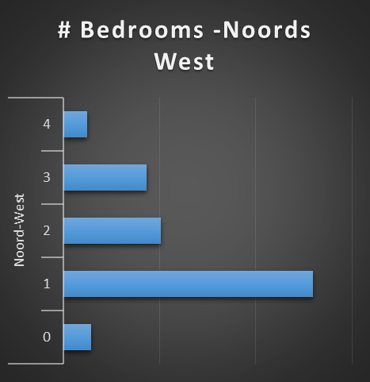
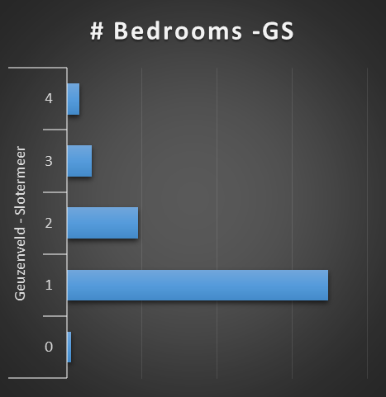
#Bedrooms by Neighborhood

Slide 14
Key Question(s)
Which neighborhood should the investor make an investment ?
a) Which boroughs ?
b) Which neighborhoods within the boroughs?
c) Invest in Home vs Apartment?
d) Identify top one or two neighborhoods.
Notes:
Feel free to add notes here

Slide 15
Final Recommendation
With a medium risk appetite, investment should be split into
1. Low Risk: Tried and tested popular Neighborhood, Zuid
2. Moderate Risk: Guezenveld Slotermeer
GS and NW have comparable popularity, monthly income
However GS is recommended as it has lower Expense/Monthly Income ratio and a closer proximity to touristy spots
Notes:
Rephrase first line – crsper
Make clear f you want ppl to invet in NW

Slide 16
Final Recommendation- Contd
What type of houses/apartment should be bought?
Buy more houses in Zuid as it is an established Airbnb neighborhood. Zuid already has a high concentration of apartments
Buy more 2-3 bedroom apartments in GS as it is dominated by 1 bedroom apartments

